Slide 1

INSTITUTE OF ENGINEERING & TECHNOLOGY, LUCKNOW
PLACEMENT BROCHURE
DEPARTMENT OF COMPUTER SCIENCE 2018-19

Slide 2
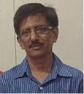
Message from
The Head of Department
The Department of Computer Science and Engineering of IET Lucknow has been the pioneer department since the establishment of the college. This department has a vibrant student body numbering over 500 and faculty numbering nearly 30, furnishing quality education. Over the past years this department has developed distinct style and methods to fill in the theory-practice crevasse while remaining grounded to the core. Technology changes rapidly as in the field of computer science and our understanding is if a person’s basics is clear then it can adapt to changes easily. Our department has produced thousands of professionals and have earned for itself in the country as well as in abroad. Learning is a continuous process and we aim at giving our students a strong foundation in computer science and problem solving techniques.
Dr. Surya Prakash Tripathi
Head, Department of CS

Slide 3
About the Department
In the view of increasing importance of Computer Science discipline, the department of computer science and engineering was established in 1984 with a view to contribute to the journey of the global academic excellence and touch every aspect of national life. It administers Bachelors as well as Master’s degree program in Computer Science and Engineering. Renowned faculty, high faculty to student ratio, focus on undergraduate education balanced with leading edge research, and emphasis on developing qualities like leadership, service and ethics leading to the overall development of a student is the primary goal of the department.
The department takes pride in having a equipped teaching and research laboratories. Since its establishment in 1984 and its expansion in 1998 the department has never looked back, it has been a premier centre for imparting quality education to its students and thus adding up to the laurels for the college.

Slide 4
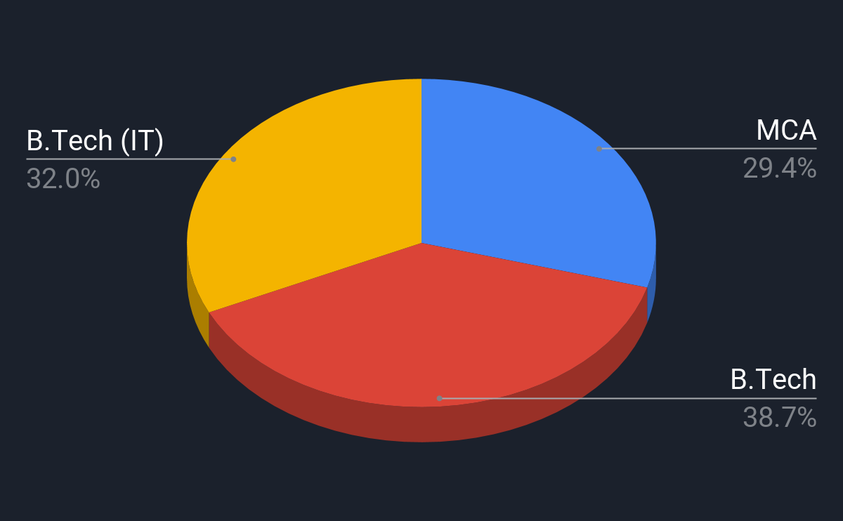
Courses Offered
Software Engineering
Computer Networks
Operating System
Computer Organization and Architecture
Data Structures and Algorithms
Design and Analysis of Algorithm
Computer Graphics
Object Oriented Technique
Database
Discrete Mathematics
Digital Design
Microprocessor
Programming Languages: C, C++, Python, HTML, CSS, JAVASCRIPT, JAVA, JSP

Slide 5
Labs and Facilities
The Institute paces its technical education with 3 of its well-equipped computing laboratories and a digital Lab. These life-lines of the Institute manages all the computational and network services. IET Lucknow has an extensive fiber optic network over the entire campus. The Internet connectivity to the campus is through a dedicated 2 Gbps leased line from National Informatics Centre, serving academic block, administrative block, computer center, all hostels and faculty residents counting to a total of 1500 LAN terminals.

Slide 6
Technical Club and Initiatives
The Institute paces its technical education with 3 of its well-equipped computing laboratories and a digital Lab. These life-lines of the Institute manages all the computational and network services. IET Lucknow has an extensive fiber optic network over the entire campus. The Internet connectivity to the campus is through a dedicated 2 Gbps leased line from National Informatics Centre, serving academic block, administrative block, computer center, all hostels and faculty residents counting to a total of 1500 LAN terminals.

